Slide 1
Credit Risk Analysis
AI Boot Camp Project 2
Team Members:
Anand Bhagwat
Usha Hariharan
Asif Mahmud
Venkat Varun Thamma

Slide 2
Project Overview
Project Purpose / Description
This project showcases the application of machine learning models to analyze and predict borrower credit grades using financial data.
Leveraging advanced datasets and methodologies provides valuable insights to support smarter and more informed lending decisions.
Empowers institutions and borrowers

Slide 3
Project Overview
Goals/Problem to be solved
Analyze/ Predict borrower creditworthiness using AI models.
Identify the most impactful features for assessing credit risk.
Compare the performance of multiple models to find the most accurate and efficient.

Slide 4
Project Overview
Data Extraction
Kaggle ”Credit Risk Dataset”
https://www.kaggle.com/datasets/ranadeep/credit-risk-dataset/data
Original dataset 887,000 entries rows of raw financial data
Random Sample Size 15% of the above set—133,107 entries with 74 columns
Key Attributes:
Loan Amount (`loan_amnt`)
Interest Rate (`int_rate`)
Debt-to-Income Ratio (`dti`)
Home Ownership (`home_ownership`)
Loan Status (`loan_status`)
Annual Income (`annual_inc`)

Slide 5
Project Overview
Data Cleaning and Transformation
Identified columns with null values
Reduced the dataset to only necessary columns, from 74 to 13 columns
Created new features: `funded_amnt_to_annual_inc` and `revol_bal_to_annual_inc`.
Changed home ownership, grade, loan status, and term to numerical values
Defined grade and loan status as ‘y’ columns

Slide 6
Project Overview
Overview of Exploratory Data Analysis (EDA)
Visualized key feature distributions and their relationships to credit grades.
Examined correlations between variables.
Visuals on next slides:

Slide 7

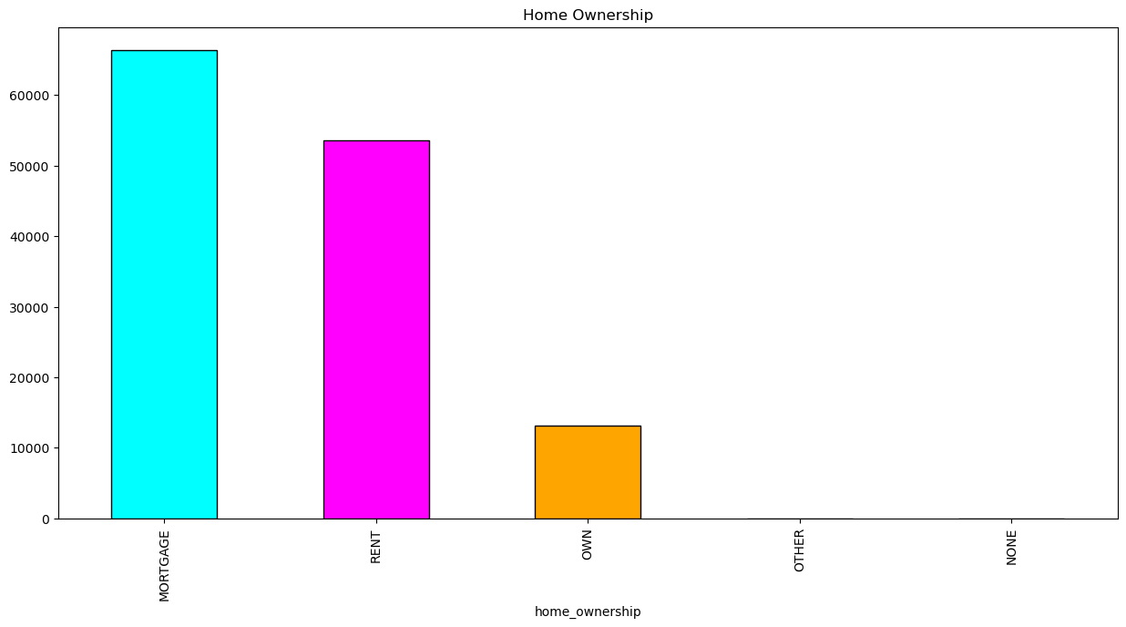
Dataset Count – Homeownership Type

Slide 8
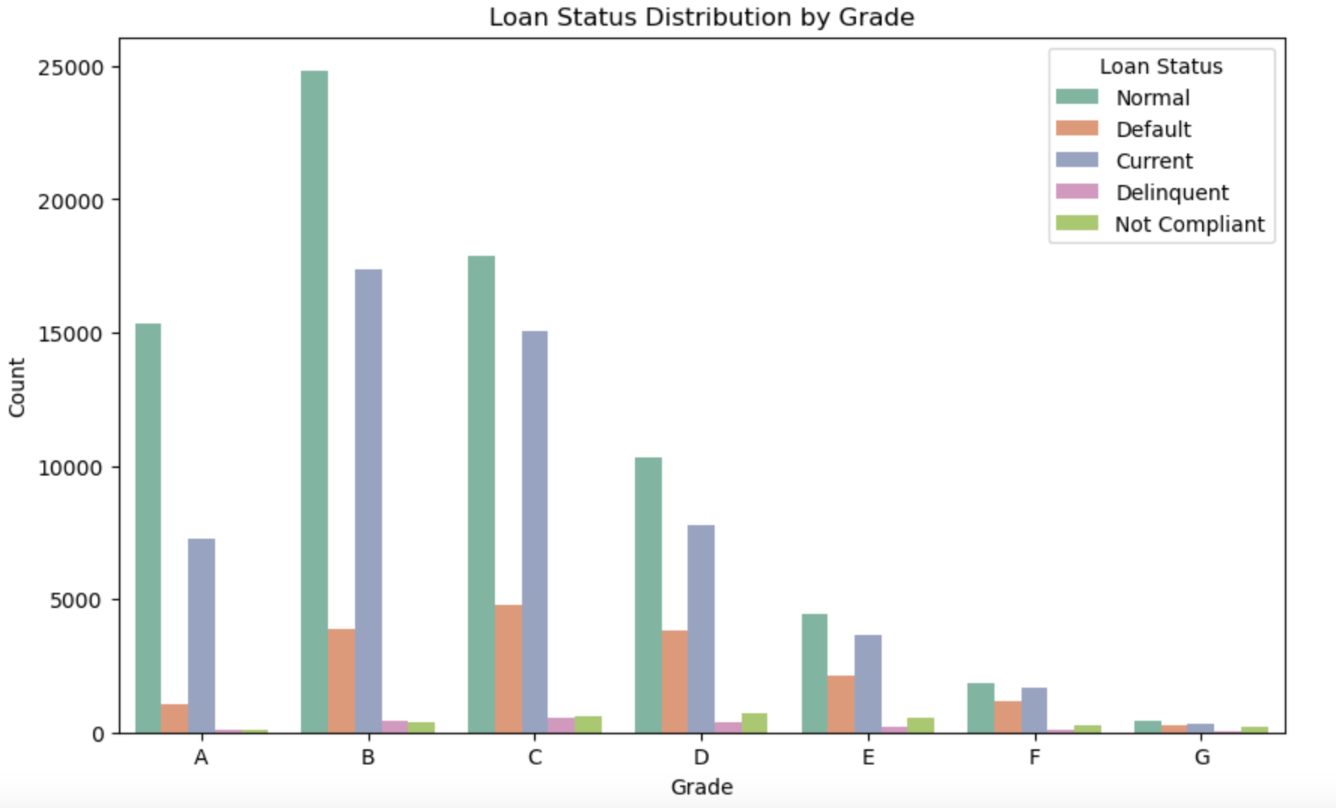
Dataset Count – Loan Status by Grade

Slide 9
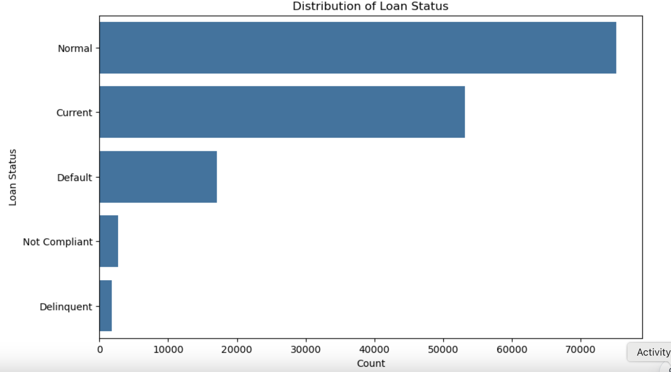
Dataset Count – Loan Status

Slide 10
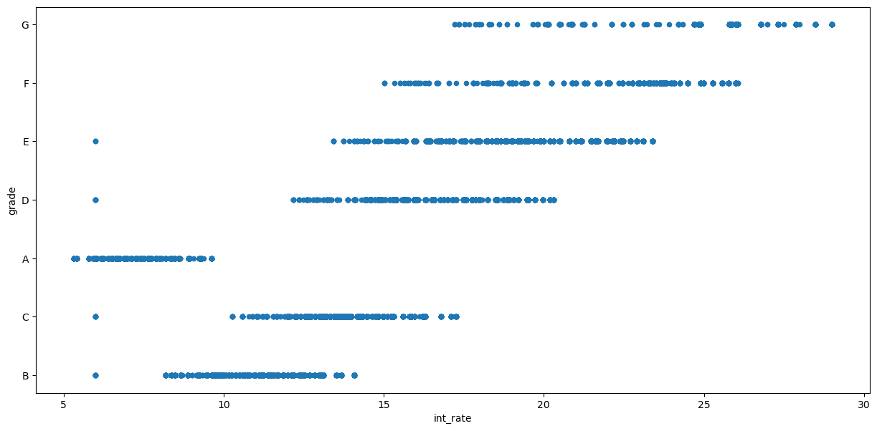
Dataset – Grade Assignment as a function of

Slide 11
Project Overview
Approach taken to achieve goals
Feature Importance:
Identified top predictors such as `int_rate`, `installment`, and `loan amnt’.
Visualized feature importance using horizontal bar plots (next slide)

Slide 12

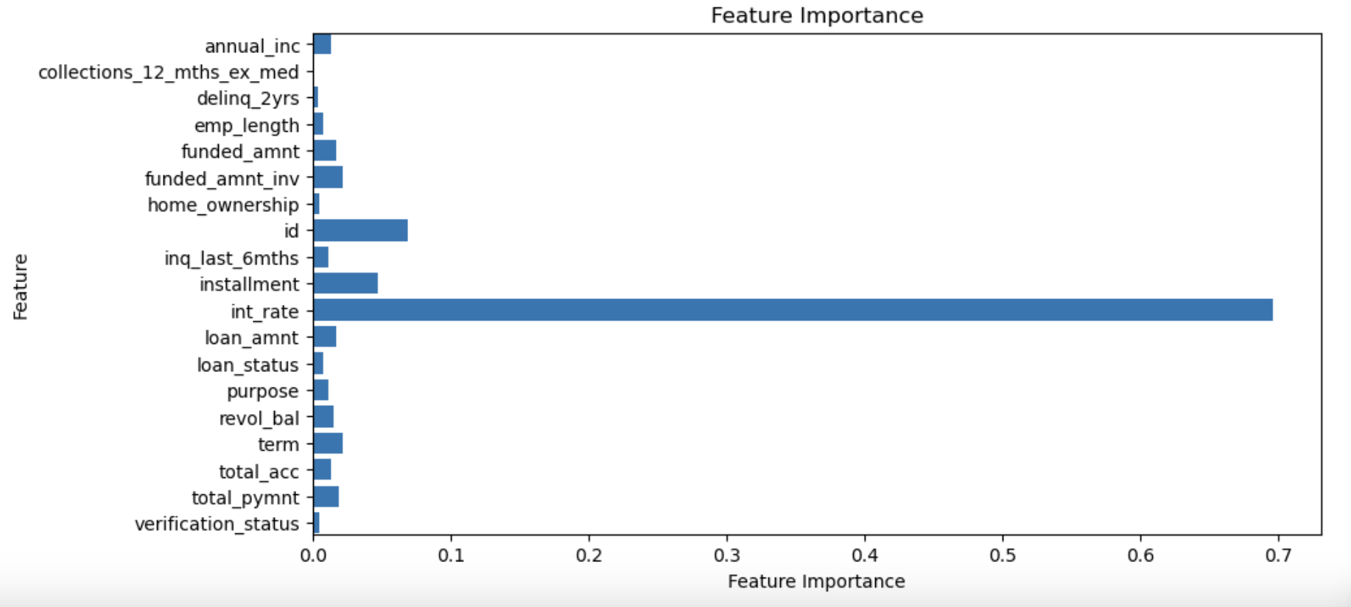

Slide 13
Project Overview
Model Optimization and Evaluation
Split data into training and testing sets.
Scaled features using `One Hot Encoding’-–loan status, grade
Scaled features using ‘Label Encoder’---ordinal variables

Slide 14
Project Overview
Model Optimization and Evaluation
Trained multiple models
Linear Regression: R² score of 93.3%
Random Forest
XGBoost

Slide 15
Result/Conclusion 1
MODEL PERFORMANCE: RANDOM FOREST
Random Forest achieved a testing accuracy of 96.2 %
High accuracy effectively classifies loan status, and can identify default risks
High-impact feature such as int_rate provides predictive power

Slide 16
Result/Conclusion 2
MODEL PERFORMANCE: XGBoost
XGBoost**: Precision, Recall, and F1-scores close to 1.0 for all classes.
XGBoost achieved near-perfect precision, recall, and F1-scores
Overall accuracy rate of 99%
Handled imbalanced classes by focusing on the most significant features

Slide 17
Result/Conclusion 3
KEY INSIGHTS:
*. Interest Rate (int_rate): This was the most influential feature in determining loan grade.
* Feature Engineering: Significantly improved model performance
*Introduction of new features such as funded_amt_to_annual_inc and revol_bal_to_annual_inc
*Contextualized borrower’s financial situation better

Slide 18
Summary
The grade and loan status were chosen as Y values to determine borrower credit risk
Machine learning model created using Grade as the determinant has a better predictor of credit risk
Machine learning model created using loan status as the determinant has less predictive accuracy of credit risk

Slide 19
Problems Encountered
Data Quality: Size of data sets were large and difficult for Github to process for expedient analysis
Class Imbalance: Even with n_estimators = 200, the accuracy for loan status was subpar
High Dimensionality: Selection of models to utilize was difficult; for example, SMOTE was dropped due to poor results

Slide 20

FUTURE ML ENHANCEMENTS:
Hyperparameter Tuning: Incorporating hyperparameter optimization for Random Forest and XGBoost to improve performance further.
Additional Datasets: Our models can be further validated with additional datasets to ensure they generalize well with other types of loans
Real-time Dashboard: Live dashboard can provide real-time credit scoring and loan risk assessments
Future Considerations

Slide 21
FUTURE FORWARD CREDIT CONSIDERATIONS:
Emerging / alternative data sources: social, connected device data
Environmental/social sustainability metrics: spending pattern alignment with ethical and community welfare practices
Blockchain and decentralized credit scoring: scoring metrics based on smart contracts, blockchain transactions, and wallet activity
Real-time and Dynamic scoring: real-time analysis of transactions and adjustments for critical life events
Ethical and Inclusive models: bias-resistant models, creating nontraditional scoring models that support credit extension to underserved populations
Network-based creditworthiness: peer influence models, group creditworthiness
Hybrid models: FICO+ ML derived alternative data
Future Considerations

Slide 22
FUTURE FORWARD CREDIT CHALLENGES:
Key Challenges to Address
While these paradigms offer tremendous potential, they also present challenges:
Data Privacy and Security: Safeguarding sensitive consumer data.
Fairness and Bias Mitigation: Ensuring equitable access and avoiding systemic bias.
Regulatory Compliance: Aligning innovations with strict regulatory frameworks.
User Trust: Building confidence in nontraditional scoring methods.
Exploring these paradigms in credit risk can revolutionize financial inclusion, improve risk accuracy, and cater to the evolving financial ecosystem.
Future Considerations

